Slide 1

FANet: A Feedback Attention Network for Improved Biomedical Image
Research Report
October, 2026

Slide 2
Title
Abstract
Contributions (Performance, Impact, Novelty in your mind)
A brief summary of the key gaps in related work and your main idea to solve the problems
Methods (brief)
Evaluation setting
Performance evaluation (quantitative & qualitative)
Ablation studies
For (7) and (8), please compile all tables and figures you plan to include in the paper (values can be left blank).
The goal is to share the overall paper structure, identify critical issues, get constructive feedback, and help authors prepare their draft early.

Slide 3
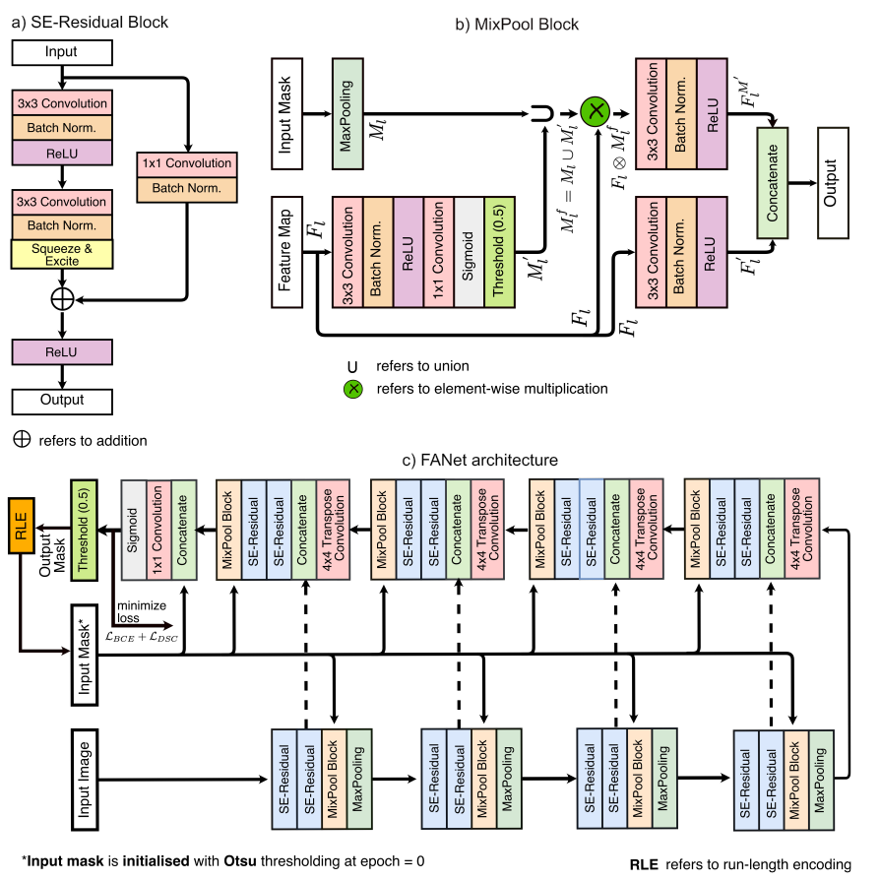
Baseline
Problem:
Methods typically perform single-pass prediction
Prediction errors are not explicitly fed back to the network for further refinement
Limited ability to iteratively correct segmentation errors
Solution:
FANet without MixPool → used as the baseline B1
No feedback mechanism.
No iterative pruning/refinement.
Compare B1 with the full FANet (B4) to evaluate the contribution of the proposed feedback mechanism.
Nikhil Kumar Tomar, Debesh Jha, Member, IEEE, Michael A. Riegler, Member, IEEE, H˚avard D. Johansen, Member, IEEE, Dag Johansen, Member, IEEE, Jens Rittscher, Member, IEEE, P˚al Halvorsen, Member, IEEE, and Sharib Ali, Member, IEEE

Slide 4
Title
FANet: A Feedback Attention Network for Improved Biomedical Image

Slide 5
Abstract
FANet (TNNLS 2022) feeds its previous binary prediction back into the network to refine polyp segmentation.
Reproducing it on sessile Kvasir-SEG exposes two structural flaws: the learned attention branch never trains, and binary foreground-only feedback amplifies over-segmentation (FP/FN = 2.48).
In a controlled 2×2 ablation — feedback × {DiceBCE, asymmetric Tversky α=0.7/β=0.3} — the asymmetric loss reduces FP by 3.25pp (p = .005) with unchanged Dice.
This holds only when feedback is disabled; with mask feedback, FP does not improve (interaction = +4.17pp).
The mask-at-input feedback loop thus blocks loss-side FP suppression — a systematic negative-result with two reproducibility findings.

Slide 6
Contributions
Performance
FP 6.53% → 3.28% (−3.25 pp, p = .005, 27/40 ảnh) bằng asymmetric Tversky (α=0.7/β=0.3), Dice không đổi.
Chỉ đạt được khi tắt feedback; giữ feedback thì FP không giảm (interaction +4.17 pp).
Không đổi kiến trúc (~7.7M params) — chỉ thay loss.
Novelty
Ablation 2×2 đầu tiên tách feedback vs loss trên FP, định lượng interaction (+4.17 pp).
Chẩn đoán cơ chế: nhánh attention chết (0/160 gradient); feedback nhị phân gây over-segmentation (FP/FN = 2.48).
Khung negative-result có kiểm soát và phát hiện soft-dice che giấu collapse.

Slide 7
Key gaps in related works and main idea
Gap | Description
FANet uses hard binary mask-at-input feedback | Recent polyp methods favor soft/internal feedback (FEGNet, RefineU-Net); FANet's design is the known-weak branch.
Loss-side FP penalties never ablated against feedback | wIoU+wBCE, Tversky and focal are standard in polyp segmentation, but untested against FANet's feedback mechanism
Source of FP improvement is confounded | No study isolates whether FP gains come from the loss or from feedback's own prune/suppress role
The main Idea:
- Run a controlled 2×2 factorial {feedback, no-feedback} × {DiceBCE, asymmetric Tversky} to attribute FP changes to loss, feedback, or their interaction.- Track per-image FP/FPR, precision and recall, logging binary val-metrics every epoch.- Show that mask-at-input feedback blocks loss-side FP suppression (interaction +4.17 pp).

Slide 8
Method (brief)
1. Baseline — FANet. 4-level encoder–decoder (~7.7M params) with MixPool feedback attention: a learned attention map fmask is combined with the previous prediction mask via a hard gate keep = max(fmask, m_fg), and the binary mask is concatenated to the output head. Feedback is cross-epoch (mask updated on val improvement), initialized by Otsu.
2. Asymmetric loss. L = 0.5·DiceBCE + 0.5·Tversky(α=0.7, β=0.3), where α penalizes FP and β penalizes FN; TI = |PG| / (|PG| + α|P\G| + β|G\P|).
3. 2×2 factorial. Four cells under one protocol: T00 (feedback × DiceBCE), T0N (no-feedback × DiceBCE), TC (feedback × asymmetric), TD (no-feedback × asymmetric). "No-feedback" feeds a zero mask.
4. Training. 200 epochs, Adam lr 1e-4, batch 2, 256×256, ReduceLROnPlateau (patience 5), Kaggle T4.Evaluation. 4-iteration test-time refinement, per-image Dice/IoU/FP/FN/precision/recall, binary val-metrics logged every epoch; paired Wilcoxon + bootstrap CI + Bayes BF10.

Slide 9
Evaluate settings
Dataset: Kvasir-SEG sessile subset — 196 images split 156 train / 40 val, resized to 256×256; a single fixed split (no test set; val used for evaluation).
Protocol: 4-iteration test-time refinement with Otsu initialization; predictions thresholded at 0.5.
Metrics: Per-image Dice, IoU, FP%, FN%, Precision, Recall and FPR; binary val-metrics (Dice/Precision/Recall/FPR) logged every epoch to avoid the soft-dice-masks-collapse pitfall.
Statistics: Paired per-image Wilcoxon signed-rank, rank-biserial effect size, bootstrap 95% CI, and Bayesian BF10; comparisons are within the same split/protocol.
Pre-registered gate: A cell passes if FP < baseline − 0.01 AND Dice ≥ baseline − 0.02 AND FN ≤ baseline + 0.02; divergence checked at epoch 40 on binary val-Dice.
Power: With n = 40, the minimum detectable Dice effect is ≈ 0.13; FP has smaller variance, so it is the primary metric.
Evidence tiers: Results labeled TRAIN (trustworthy, 1 seed), FROZEN eval, or INVALID (bug); only TRAIN evidence supports the claims.

Slide 10
Qualitative Results
Feedback behavior:
Without feedback (T0N / TD):
  Asymmetric loss progressively contracts the foreground
  Produces tighter polyp boundaries
  Removes spurious background blobs
With feedback (T00 / TC):
  Masks tend to converge to the previous polyp region
  Can retain distant false positives
  TC keeps more over-segmented regions

Slide 11
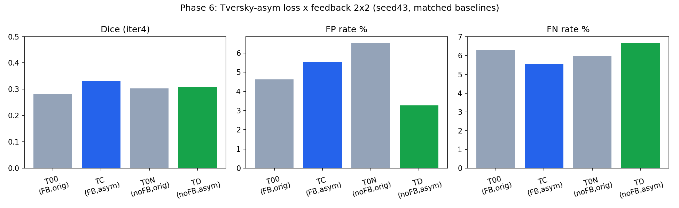
Final metrics per cell

Slide 12
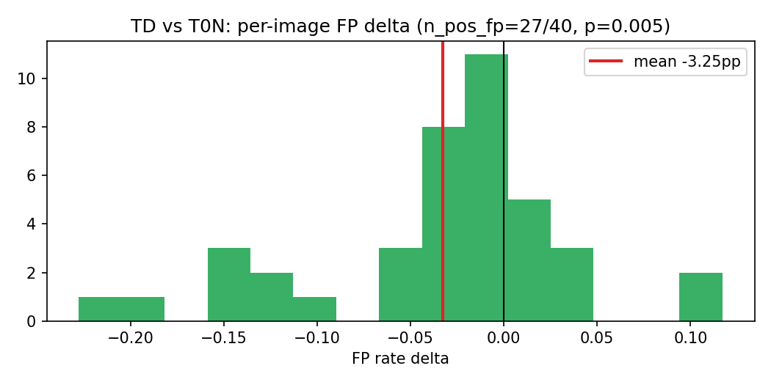
Paired ΔFP: TD vs T0N (27/40 ảnh giảm FP)

Slide 13
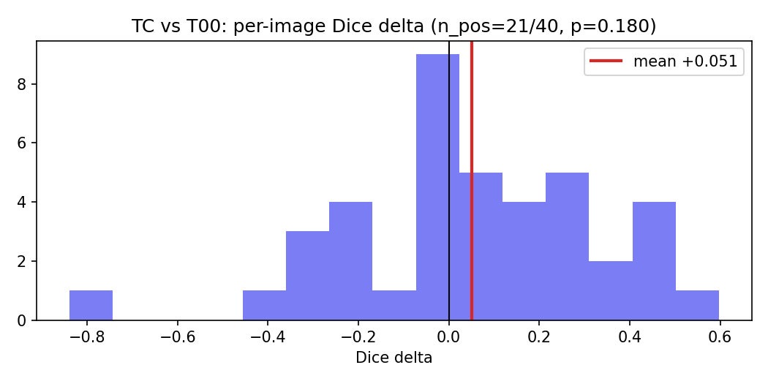
Paired ΔDice: TC vs T00 (21/40 ảnh)

Slide 14
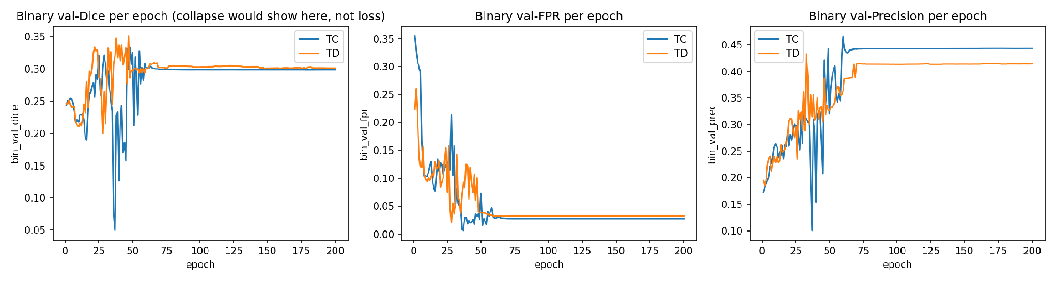
Training curves (binary val-Dice/FPR per epoch)

Slide 15
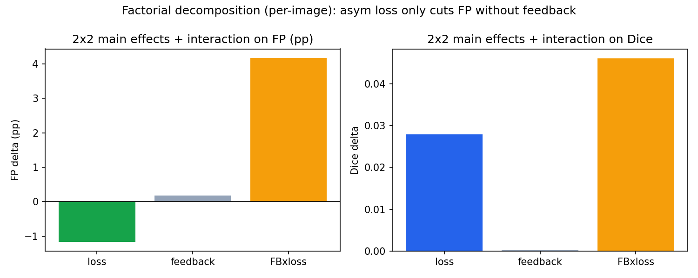
Factorial main effects and interaction

Slide 16
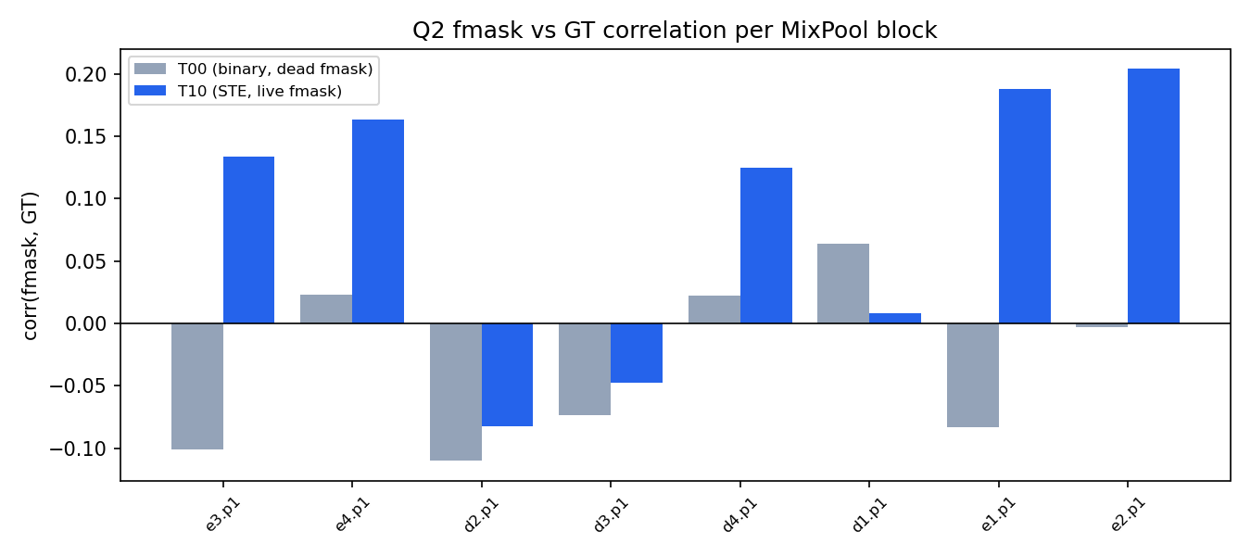
Fmask không học (nhánh attention chết)

Slide 17
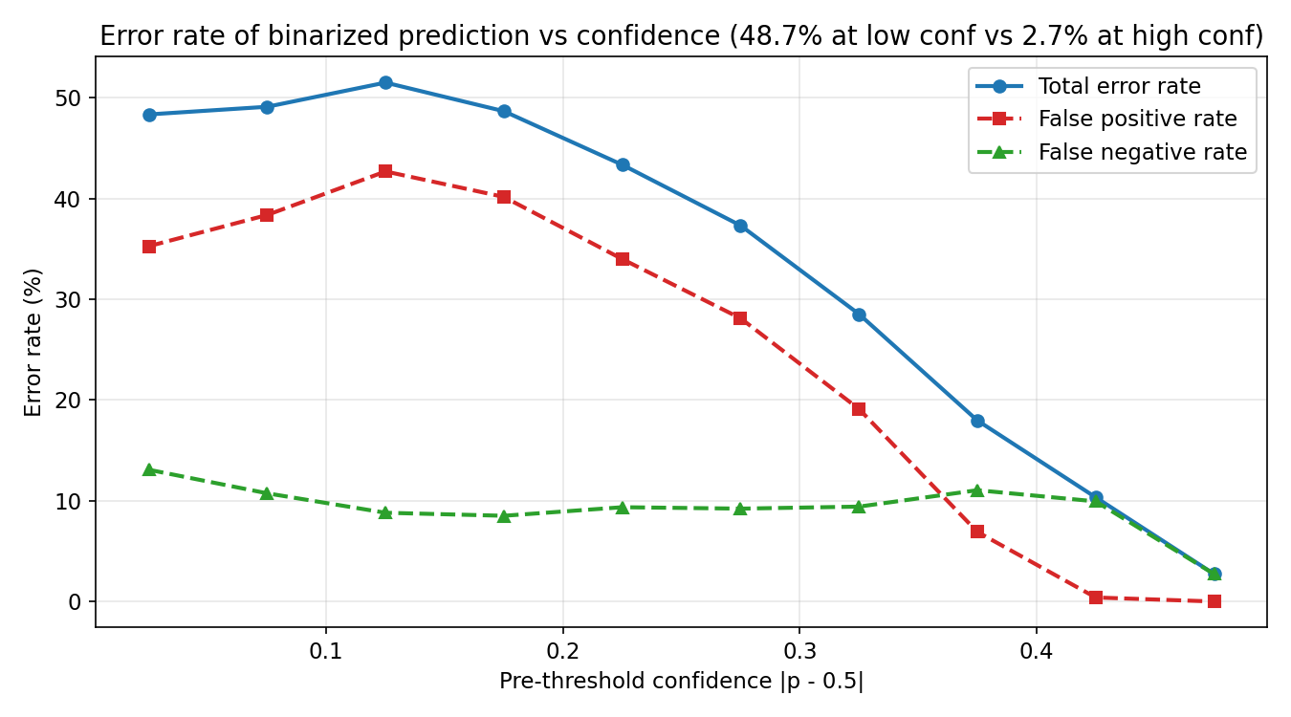
Lỗi theo confidence (feedback quá thô)

Slide 18
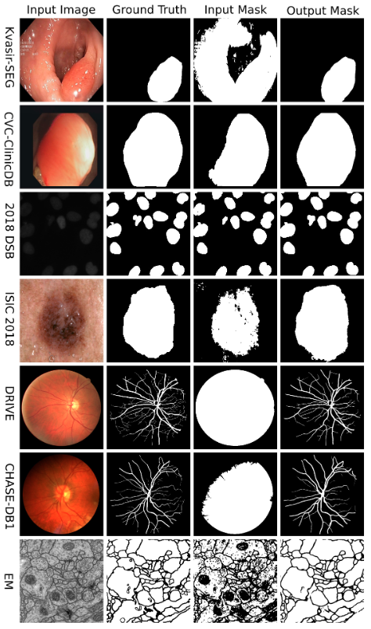
Qualitative montage

Slide 19
Thank you for listening
Notes:
Good bye

